Slide 1
Ecosystems and Communities
Chapter 4

Slide 2
Weather
Weather is the day-to-day condition of Earth’s atmosphere at a particular time and place.
The weather in Regina could be sunny and warm one day, and cold and cloudy the next.

Slide 3
Climate
Climate refers to the average year-after-year conditions of temperature and precipitation in a particular region.
Climate is caused by a combination of factors including the heat trapped in the atmosphere, the latitude, the transport of heat by winds and ocean currents, and the amount of precipitation in a region. The shape and elevation of the land also contributes to the local climate and global climate patterns.
Video: (3 min)https://www.youtube.com/watch?v=bjwmrg__ZVw

Slide 4
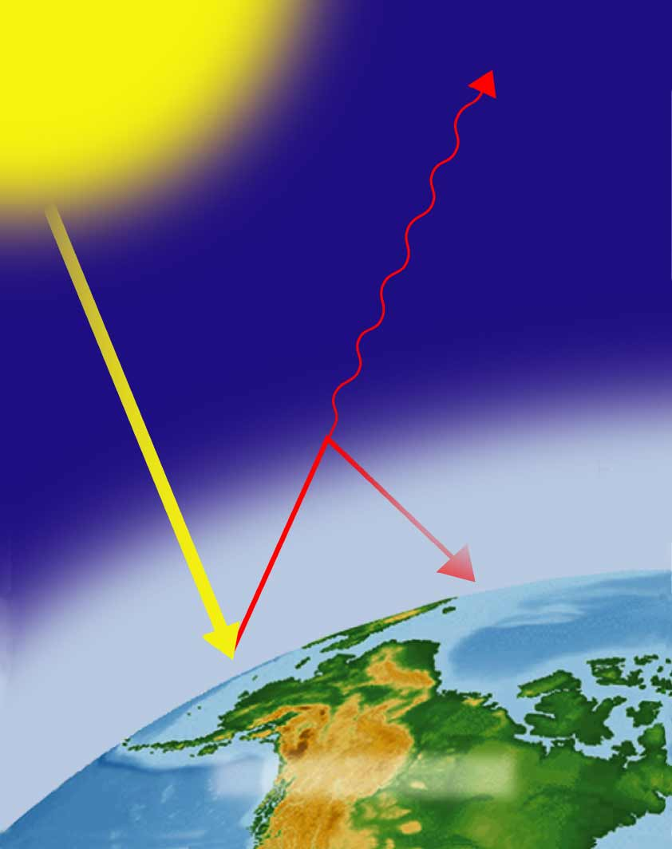
What is the greenhouse effect?
The gases that are trapped in the atmosphere act like windows in a greenhouse. They cause the heat to stay within the atmosphere. Without the greenhouse effect, the earth would be about 30 degrees cooler on average.
Some heat
escapes
into space
Greenhouse
gases trap
some heat
Atmosphere

Slide 5
Latitude and Climate
Earth is a sphere that is spins on a tilted axis, which means that solar radiation strikes different parts of the earth at an angle that changes throughout the year. At the equator, the sun is directly overhead at noon all year, whereas at the North and South poles, the sun is much lower in the sky for months at a time.

Slide 6
Climate Zones
As a result of differences in latitude and thus the angle of heating, Earth has three main climate zones:
Polar zones: cold areas where the sun’s rays strike Earth at very low angle. These zones are near the North and South poles, between 66.5° and 90°, both North and South.
Temperate zones: between the polar and tropical zones. The temperature in these zones ranges from hot to cold, depending on the season. This depends on the changing angle of the sun over the course of the year.
Tropical zones: the area near the equator, between 23.5° North and 23.5° South latitudes. The tropics receive direct or nearly direct sunlight year-round, making the climate consistently warm.

Slide 7
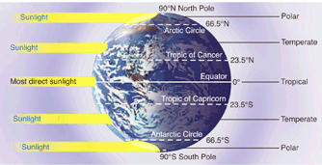
Figures 4-1 and 4-2 Heating of the Earth’s Surface and Some Factors That Affect Climate
Effects of Latitude on Climate
Section 4-1

Slide 8
Climate Zones

Slide 9
Heat Transport in the Biosphere
Unequal heating of the earth’s surface affects currents in both wind and water; as air and water are cooled at the poles and warmed near the equator.
Warm air near the equator tends to rise and cool air from the poles tends to sink toward the ground. The movement of these air masses, along with the rotation of the earth, creates the air currents.

Slide 10
Heat Transport in the Biosphere
Ocean currents are affected by the temperature, density, and salinity (saltiness) or the oceans, as well as by the action of winds, the rotation of the earth, and the topography on the bottom of the ocean.
Wind and ocean currents create weather patterns and climates, and have major impacts on the biomes of the world.
The Thermohaline Circulation is called the Global Conveyor Belt, and in particular it has huge effects on weather and climate around the world.

Slide 11
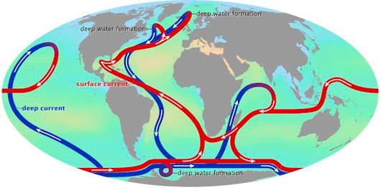

Slide 12
Videos on Climate
The Effect of Salt Content: (2 min)
http://www.youtube.com/watch?v=w_8mw-1HYFg&list=PL66FuUmM9t2bAVQT6l06NeI8xUOejYVav&index=1
Density Currents (2:40)
http://www.youtube.com/watch?v=FuOX23yXhZ8&index=4&list=PL66FuUmM9t2bAVQT6l06NeI8xUOejYVav
Surface Currents in the Ocean (4:30)
http://www.youtube.com/watch?v=YCorkyBe66o&list=PL66FuUmM9t2bAVQT6l06NeI8xUOejYVav&index=5

Slide 13
If Time
Nasa Video about the Oceans & Weather & Climate: (6 min)
https://www.youtube.com/watch?v=6vgvTeuoDWY

Slide 14
What Shapes an Ecosystem
Biotic and Abiotic Factors
Ecosystems are influenced by a combination of biological and physical factors.

Slide 15
Biotic Factors
The biological influences on organisms within an ecosystem are called biotic factors.
Biotic factors include all the living things (and recently living things) with which an organism might interact.

Slide 16
Abiotic Factors
Physical, or nonliving, factors that shape ecosystems are called abiotic factors.
Abiotic factors include:
Temperature, precipitation, humidity, wind, nutrient availability, soil type, sunlight
Biotic and abiotic factors determine the survival and growth of an organism and the productivity of the ecosystem in which the organism lives.

Slide 17
Habitat & Niche
The area where an organism lives is called its habitat. A habitat includes both biotic and abiotic factors.
A niche is the full range of physical and biological conditions in which an organism lives and the way in which the organism uses those conditions (it’s role within the ecosystem).

Slide 18
Niche
The range of temperatures that an organism needs to survive and its place in the food web are part of its niche.
The combination of biotic and abiotic factors in an ecosystem often determines the number of different niches in that ecosystem.

Slide 19
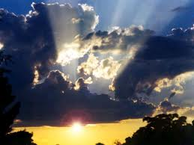
Biotic or Abiotic?

Slide 20
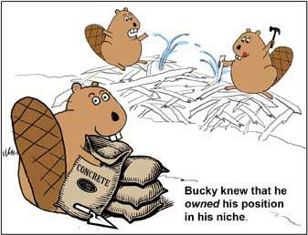
Habitat or Niche?

Slide 21
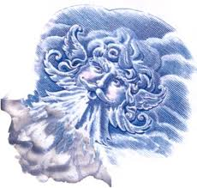
Biotic or Abiotic?

Slide 22
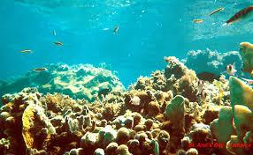
Habitat or Niche?

Slide 23
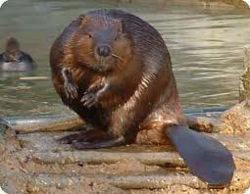
Biotic or Abiotic?

Slide 24
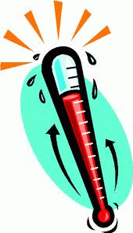
Biotic or Abiotic?

Slide 25
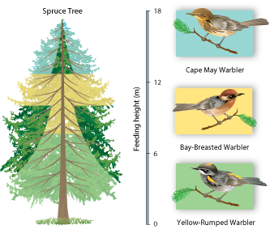
Habitat or Niche?

Slide 26
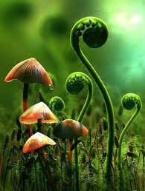
Biotic or abiotic?

Slide 27
Community Interactions
Organisms living in the same ecosystem are constantly interacting. These community interactions can powerfully affect an ecosystem. There are three main types of interactions:
Competition
Predation
Symbiosis

Slide 28
Competition
Competition occurs when two organisms (same or different species) attempt to use an ecological resource in the same place at the same time.
Example: the lynx & the great horned owl compete over their prey, the snowshoe hare
Competitive Exclusion Principle: where no two species can compete for the same resources and survive equally in the same niche in the same habitat.
This leads to niche-partitioning (each species focusing on slightly different resources)

Slide 29
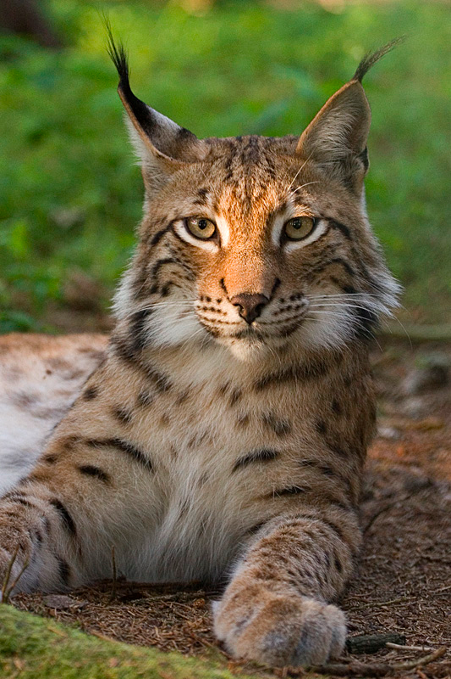
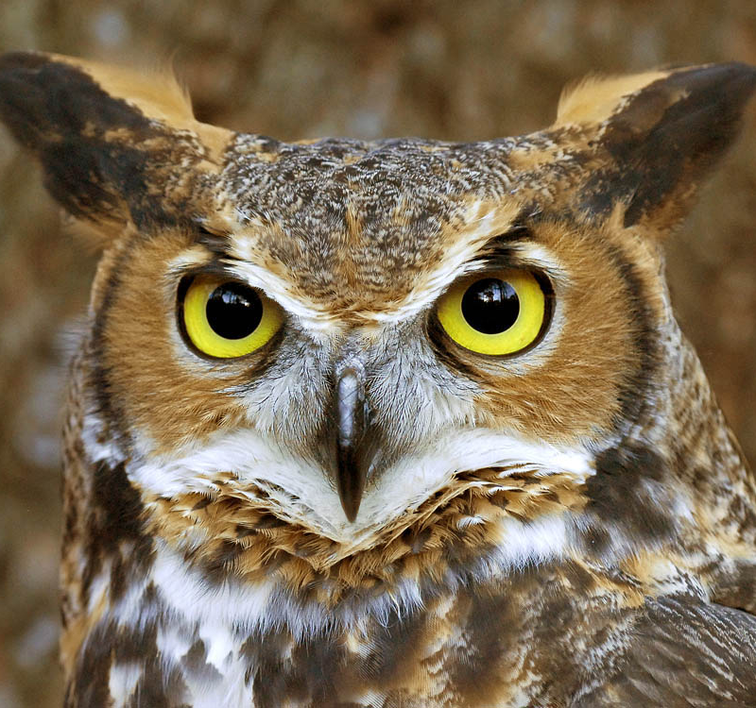
Competition

Slide 30
Competition Analogy
Who might you be in competition with?
You compete with this person for the same resources or opportunities
Some possibilities:
Siblings
Opponents in sports
Other students applying for scholarships and awards, or trying out for a play or sports team

Slide 31
Predation
Predation is the situation where one living organism becomes food for another. The predator is the organism obtaining the food, and the prey is the food source.
Example: Red-tail hawks hunt down and eat prairie dogs. Hawk = predator, Prairie Dog = prey

Slide 32
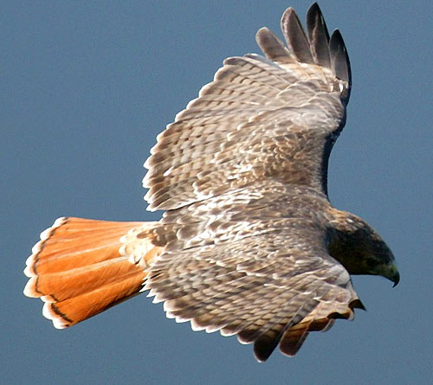
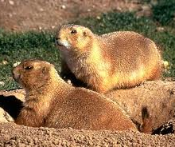
Predation

Slide 33
Predation Analogy?
What might you prey on?
In this case, let’s hope it’s not a person!
Anything you eat!

Slide 34
Symbiosis
Symbiosis is a relationship between two organisms that benefits at least one of the two organisms.
Symbiosis means living together
These relationships means there is a close, ongoing interaction between these species

Slide 35
Symbiosis
There are three types of Symbiosis.
Mutualism: both species benefit from the relationship.
Commensalism: One organism benefits and the other organism is not hurt or harmed
Parasitism: the organism lives on or inside the host without killing the host instantly but may weaken and cause death later on.

Slide 36
Mutualism
When two species both benefit from their relationship, it is called mutualism
Examples:
Nitrogen-fixing bacteria and plants they live in
the plant benefits from the nitrogen provided by the bacteria, and the bacteria benefits from the other nutrients in the plant roots, and having a place to live
Pollinators and the plants they pollinate
Insects, birds, and bats that pollinate flowers benefit from the sweet, nutritious nectar, and they help the plant by bringing the pollen to the female flowers

Slide 37
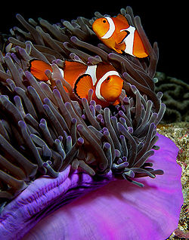
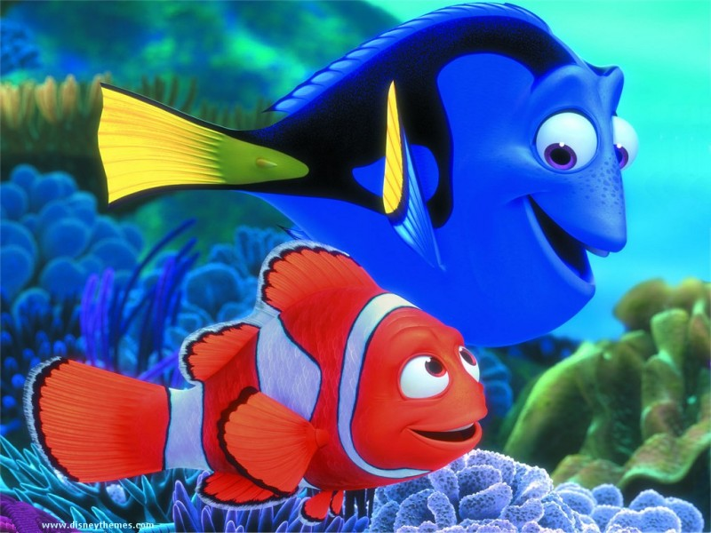
Mutualism

Slide 38
Mutualism Analogy
Who might you be in a mutualistic relationship with?
A relationship where you both benefit, more or less equally
Some possibilities:
Best Friend
Boyfriend/Girlfriend

Slide 39
Commensalism
When one organism benefits and the other is unharmed and does not significantly benefit
Examples:
Cowbirds and bison
The cowbirds benefit from the insects flushed from the grass by the bison and the bison are unaffected by the cowbirds
Remoras and sharks
Remoras latch on to the sharks, and get transport this way and also get food by either eating the shark feces (eww!!) or the shark’s leftovers

Slide 40
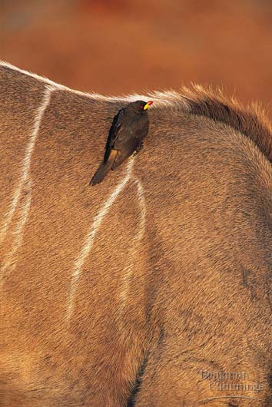
Commensalism

Slide 41
Commensalism Analogy
Who might you be in a commensalistic relationship with?
A relationship where one is benefitted, and the other is neither benefitted nor harmed
Some possibilities:
Someone you pass on your hand-me-downs to
A not-as-close friend

Slide 42
Parasitism
A condition where 2 organisms live together to the advantage of one and at the expense of the other.
Cowbirds and other types of birds
Cowbirds lay their eggs in other birds’ nests. These eggs hatch first and usually eat most of the food coming into the nest causing the chicks of the mother bird to either starve or leave the nest.
Tapeworms in humans
And lots of other things that make us sick!

Slide 43
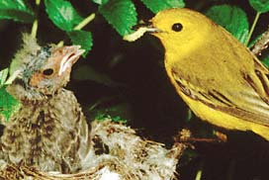
Parasitism

Slide 44
Parasitism Analogy
Who might you be in a parasitic relationship with?
A relationship where one is harmed and the other benefits
Some possibilities:
“The mooch”
A bad, unhealthy relationship
Hopefully none of you are in one right now!

Slide 45
Ecological Succession
The series of steps by which life comes back to an area after a natural or human disturbance
http://www.youtube.com/watch?v=V49IovRSJDs (6:20)

Slide 46
Primary Succession
Primary succession:
Occurs when there is no soil on the land, usually after a major disturbance like a volcanic eruption or bare rock is exposed when a glacier has melted
Takes a long time for primary succession to progress due to the need to recreate soil first

Slide 47
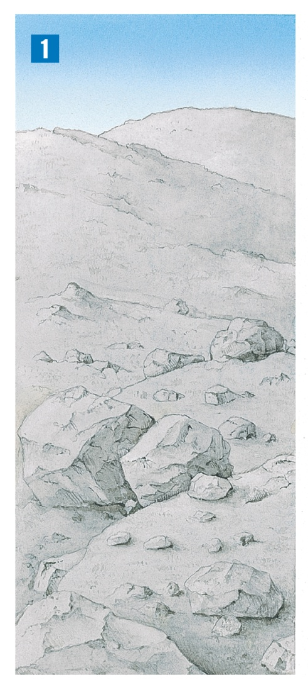
Ecological Succession
In this example, a volcanic eruption has destroyed the previous ecosystem.
Notes:
Primary succession occurs on newly exposed surfaces, such as this newly deposited volcanic rock and ash.

Slide 48
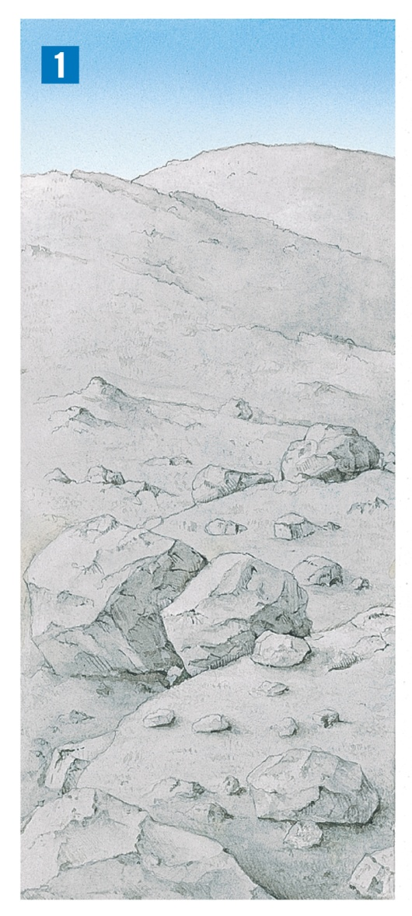
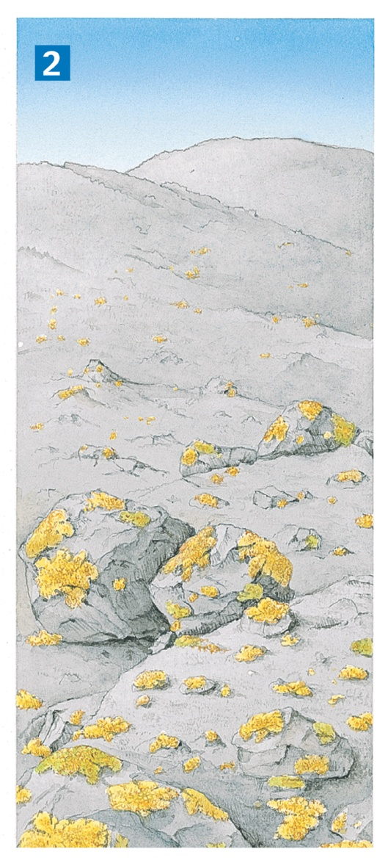
Ecological Succession
The first organisms to appear are lichens.
Notes:
Primary succession occurs on newly exposed surfaces, such as this newly deposited volcanic rock and ash.

Slide 49
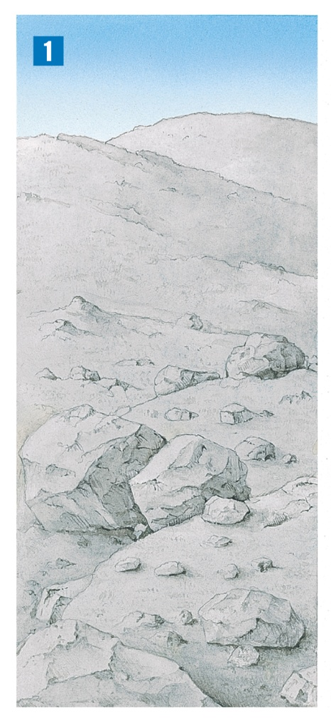
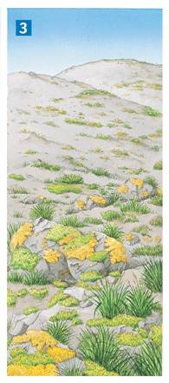
Ecological Succession
Mosses soon appear, and grasses take root in the thin layer of soil.
Notes:
Primary succession occurs on newly exposed surfaces, such as this newly deposited volcanic rock and ash.

Slide 50
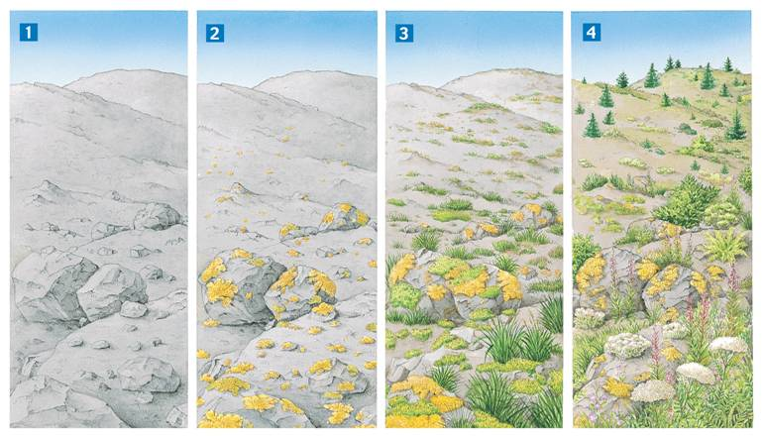
Ecological Succession
Eventually, tree seedlings and shrubs sprout among the plant community.
Notes:
Primary succession occurs on newly exposed surfaces, such as this newly deposited volcanic rock and ash.

Slide 51
Secondary Succession
Secondary succession:
When all or most of the species in an area have been killed or removed, but the soil remains
Large forest fires
Farm land that has been plowed and then abandoned
Abandoned city lots after a building is demolished
Occurs more quickly than primary succession

Slide 52
Vocabulary
Pioneer Species
Lichens and hardy weed-type plants are the first species to come back after a disturbance.
Climax Communities
The final stage of succession to an ecosystem
Old growth forests are an example.

Slide 53
Succession in a Marine Ecosystem
Succession in a Marine Ecosystem
Succession can occur in any ecosystem, even in the permanently dark, deep ocean.
In 1987, scientists documented an unusual community of organisms living on the remains of a dead whale.
The community illustrates the stages in the succession of a whale-fall community.

Slide 54
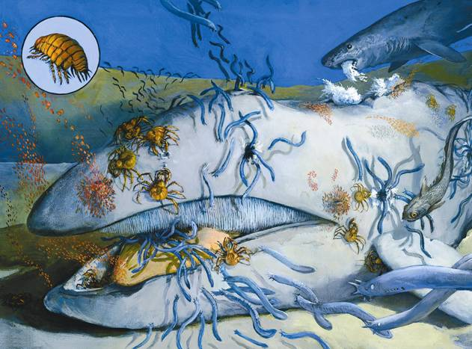
Ecological Succession
Succession begins when a whale dies and sinks to the ocean floor.
Notes:
Ecosystems are constantly changing in response to disturbances. In natural environments, succession occurs in stages. A dead whale that falls to the ocean floor is soon covered with scavengers.

Slide 55
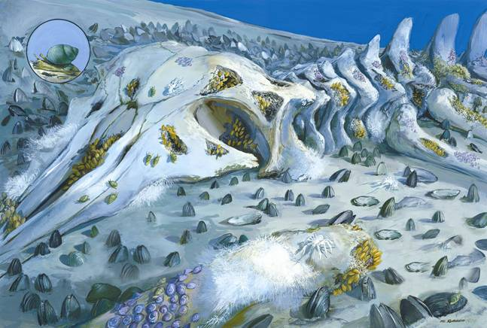
Ecological Succession
Within a year, most of the whale’s tissues have been eaten by scavengers and decomposers.

Slide 56
Ecological Succession
The decomposition of the whale’s body enriches the surrounding sediments with nutrients.
When only the skeleton remains, heterotrophic bacteria decompose oils in the whale bones.
This releases compounds that serve as energy sources for chemosynthetic autotrophs.
The chemosynthetic bacteria support a diverse community of organisms.

Slide 57
Biomes
A biome is a complex of terrestrial communities that covers a large range and is determined by certain soil and climate conditions.
Organisms exhibit variations in tolerance, or differences in their ability to survive and reproduce in conditions that are different from their optimal conditions.
Example: Plants in the desert can tolerate a wide range of temperatures, while plants in the tropics cannot withstand much variation in temperature at all
Microclimates exists within larger Biomes.
A small area that has a different climate than the area around it is called a microclimate
Some organisms depend on these localized microclimates

Slide 58
10 Terrestrial Biomes
Ten Major Biomes of the world worksheet
Use your Textbook pages (100-104) to complete the chart

Slide 59
Ten Major Terrestrial Biomes of the World
Biome | Precipitation | Temperature | Soil | Dominant Wildllife | Dominant plants | Geographic Distribution
Tropical Rain Forest
Tropical Dry Forest
Tropical Savanna
Desert
Temperate Grassland
Temperate woodland and Shrub land
Temperate Forest
Northwestern Coniferous Forest
Boreal Forest
Tundra

Slide 60
Other Land Areas
Mountain Ranges
Found on all continents
Abiotic and biotic conditions vary with elevation
Temperatures drop and precipitation increases as you move up the mountain
Rocky mountains: bottom to top
Grassland >Forests of coniferous trees > alpine meadows with wildflowers and stunted trees > bare rock with glaciers at the top of some mountains

Slide 61
Other Land Areas
Polar Ice Caps
Border the tundra and polar oceans
Cold year round, thick ice caps
5 km thick in places in Antarctica
Mosses and lichens are the major producers
Main animals:
Arctic: Polar bears, seals, insects, mites
Antarctic: Penguins, fish and marine mammals

Slide 62
Aquatic Ecosystems
All aquatic ecosystems are determined by the abiotic factors that affect them.
The depth of the water.
The flow of the water.
The temperature of the water.
The chemical make of the water.

Slide 63
Freshwater Ecosystem
Flowing water ecosystems.
Rivers, streams, creeks, & brooks
These usually originate in mountains, hills, or from an underground water source.
Types of organisms that live here:
Insects, fish, leeches, turtles, beavers, and plants

Slide 64
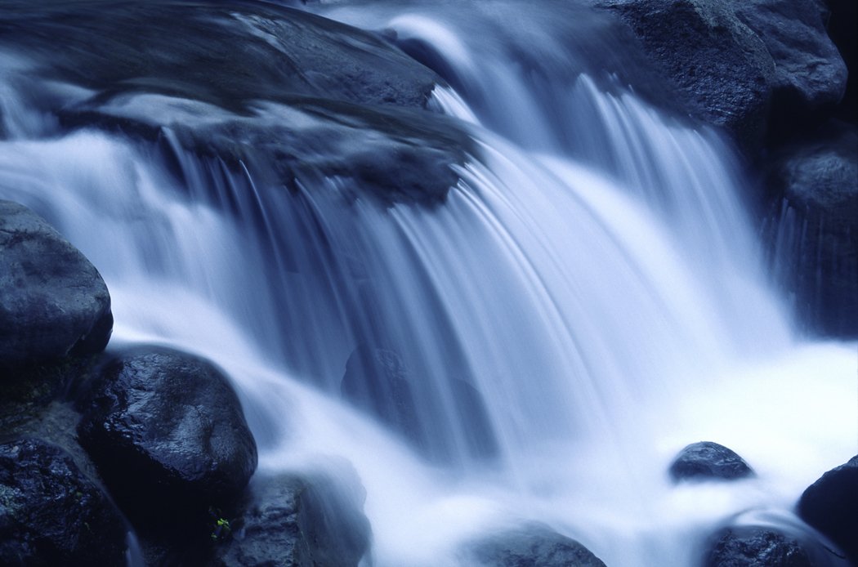

Slide 65
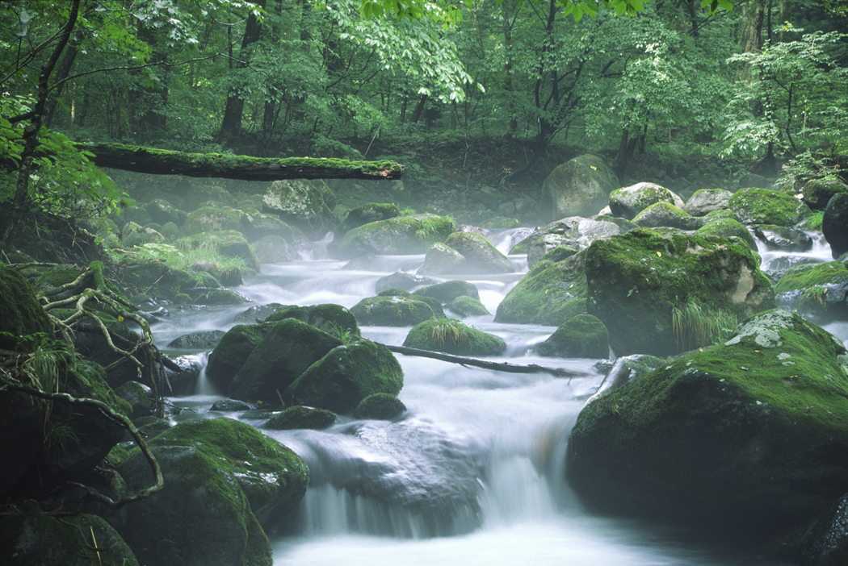

Slide 66
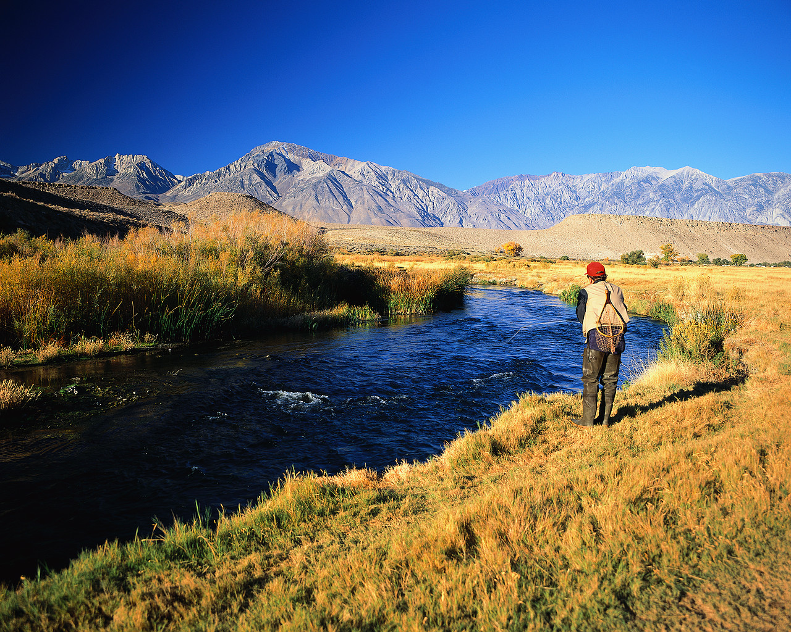

Slide 67
Freshwater Ecosystems
Standing water ecosystems
These are lakes and ponds.
Some flow in and out, but there is also water circulation within the ecosystem.
The circulation allows heat, oxygen and nutrients to be moved within the ecosystem.
Major organisms:
Plankton often inhabit the ecosystem.
Algae (phytoplankton) make up most of the producers
Small Zooplankton will feed upon the algae.
Fish, frogs, insects, plants and leeches will inhabit the ecosystem

Slide 68
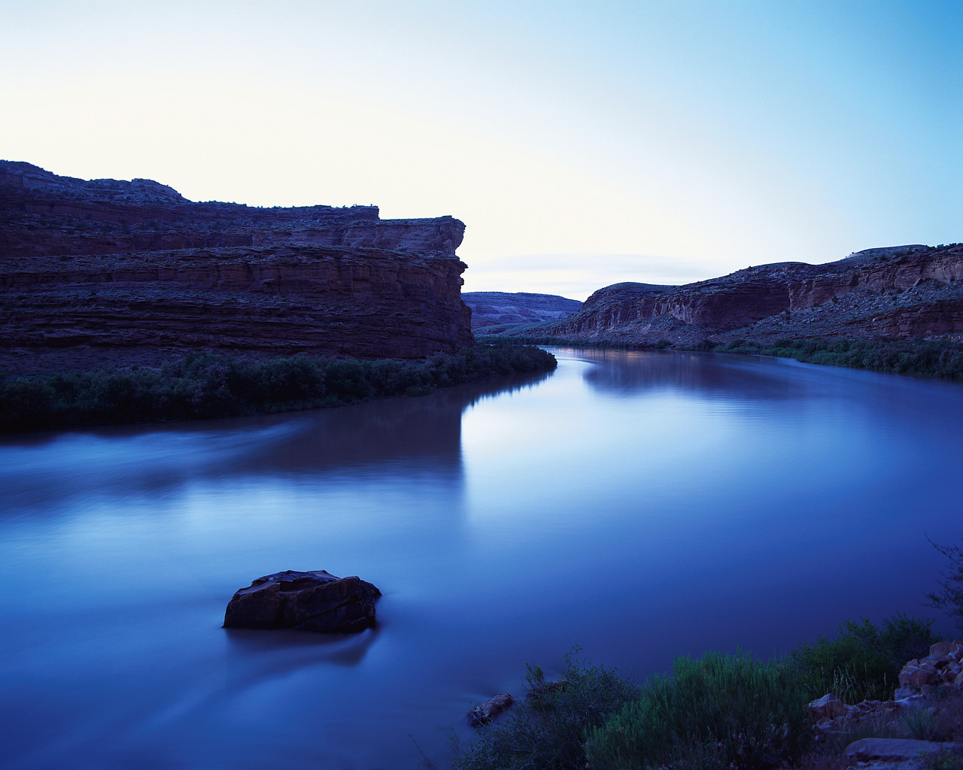

Slide 69
Freshwater Wetlands
Areas that have water either covering the soil or just below the surface of the soil for at least part of the year
Wetlands are very productive ecosystems, with many insects, fish, migratory birds, and amphibians come there to reproduce.
Three types
Bogs – mossy and very acidic
Marshes – shallow wetlands along rivers
Swamps – wet year round

Slide 70
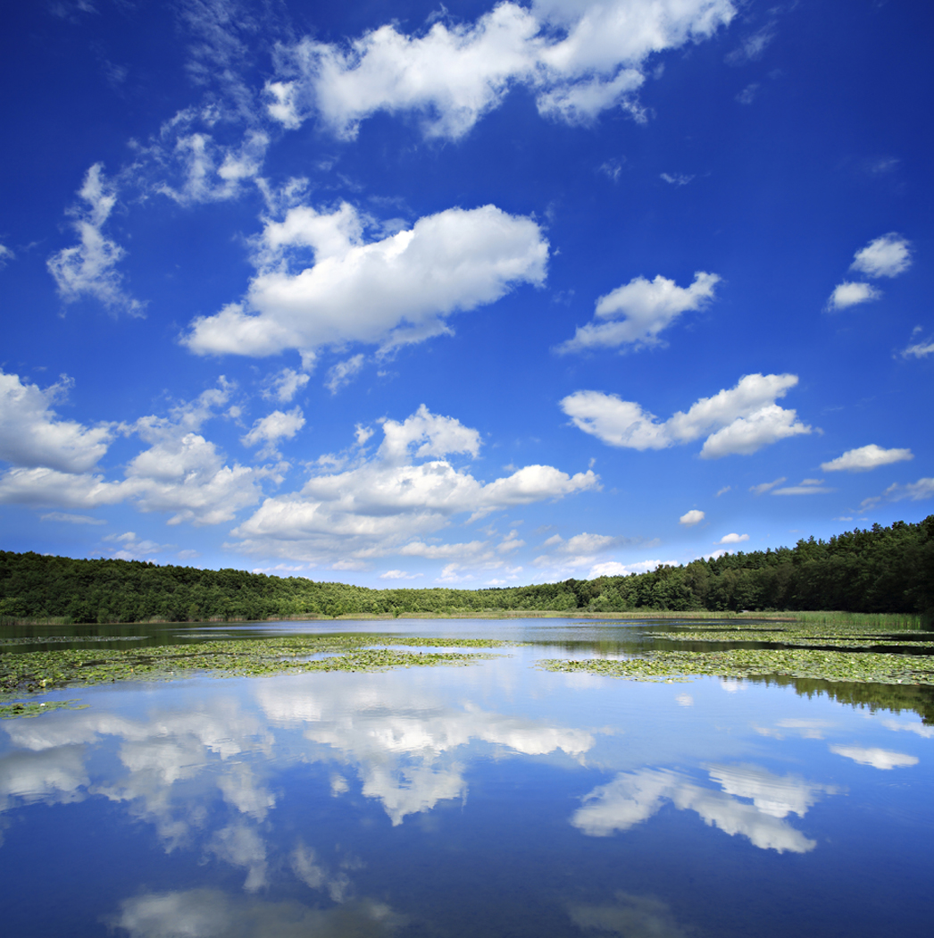

Slide 71
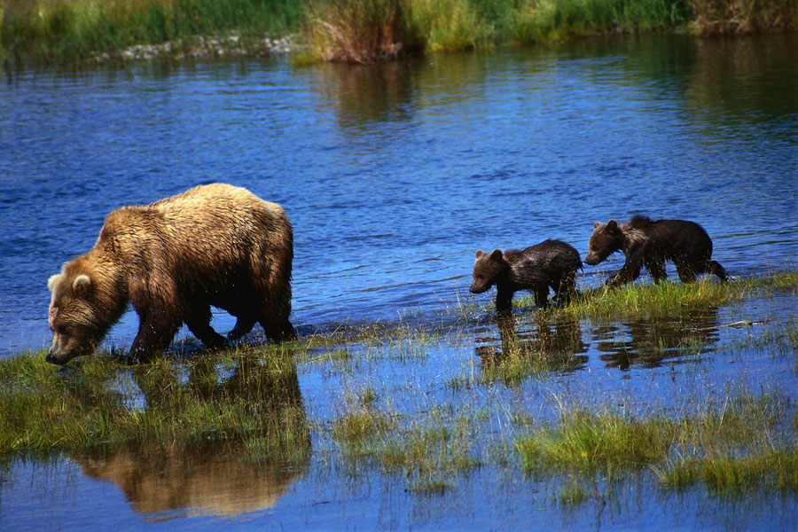

Slide 72
Estuaries
Are located where rivers meet the ocean
Contain a mixture of freshwater and salt water.
Most of the material that enters the ecosystem is detritus
Large amount of biomass is supported, but fewer species than freshwater or marine ecosystems
Major organisms:
Clams, shrimp, worms, sponges
Subtypes:
Salt marshes
Mangrove swamps

Slide 73
Marine Ecosystems
Marine systems are divided into various zones
Photic zone: relatively thin surface layer, where photosynthesis can occur (depth down to 200 m)
Aphotic zone: deeper layer, below 200m, where it is permanently dark. Chemosynthetic organisms are the only producers in this zone.

Slide 74
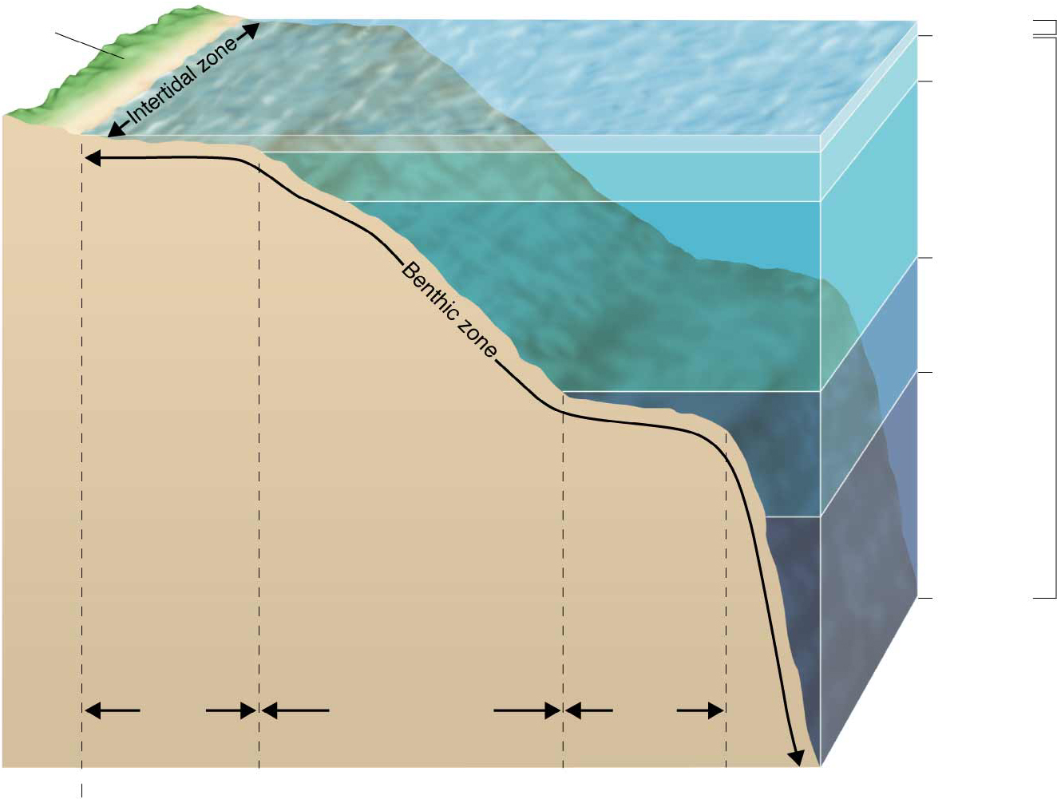
Figure 4-17 Zones of a Marine Ecosystem
Photic zone
land
200m
1000m
Coastal
ocean
4000m
Open
ocean
Aphotic zone
6000m
Continental
shelf
Ocean
trench
Continental slope and
continental rise
10,000m
Abyssal
plain

Slide 75
Marine Ecosystems
Intertidal zone
The area between low and high tide lines
Organisms here must be adapted to regular and frequent changes in their surroundings
Coastal ocean
Low tide mark to the edge of the continental shelf
Mostly within the photic zone, lots of productivity
Kelp forests in particular are very productive
Coral Reef
Found in the tropical coastal oceans
Some of the most productive ecosystems on earth
Corals are tiny animals which grow in colonies which produce hard calcium carbonate structures

Slide 76
Marine Ecosystems
Open ocean
Begins at the edge of the continental shelf
Largest zone, covers more than 90% of the surface of the oceans
Ranges from 500m deep to 11000m deep
Benthic Zone
The zone along the ocean floor
Organisms: sea stars, anemones, and marine worms
These food webs often depend on detritus that drifts down from the photic zone, or on chemosynthetic organisms

Slide 77
Notebook Quiz on Tuesday
Make sure you’ve done your readings and questions for all of Chapter 4
Complete that Terrestrial Biome Table
Remember your Article Assignment is due Tomorrow night at 11:59!
If you need help with Google Classroom – stay in at lunch!

